Slide 1
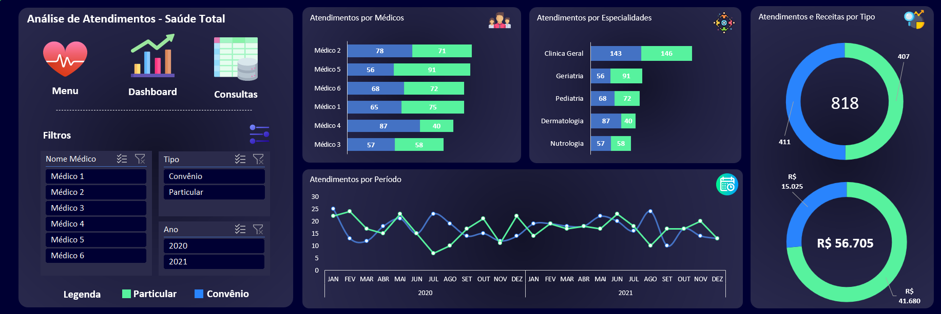
#000033
(0,0,51)
#232344
(35,35,68)
#57F29E
(87,242,158)
#4472C4
(68,114,196)

Slide 2
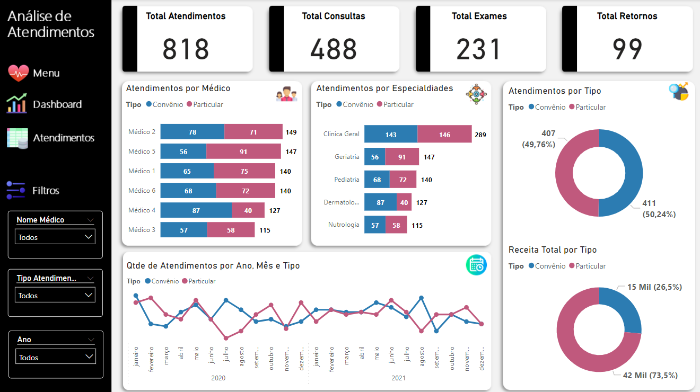
#000000
(0,0,0)
#2C7CB2
(44,124,178)
#C0597D
(192,89,125)
#F2F2F2
(242,242,242)

